Slide 1

DEPARTMENT OF COMPUTER SCIENCE TEAM 13 PREDICTION OF CHRONIC KIDNEY DISEASE BY BLOOD POTASSIUM LEVELS USING MACHINE LEARNING ALGORITHMS TEAM MEMBERS 1. B.NAGA RAJESWARI 18113103 2. S.PRIYANKA 18113087 3. M.USHA MERCY 18113122

Slide 2
ABSTRACT:
Kidney damage and diminished function that lasts longer than three months is known as Chronic Kidney Disease (CKD).
The primary goal of this research study is to identify the suitable diet plan for a CKD patient by applying the classification algorithms on the test result obtained from patients’ medical records.
The aim of this work is to control the disease using the suitable diet plan and to identify that suitable diet plan using classification.

Slide 3
INTRODUCTION:
When kidneys cannot perform their functions properly, kidney diseases may occur. The human body may end up building several complications if kidneys are no longer be able to remove extra water and waste products from the blood.
Dietary management of CKD patients relies upon the current CKD stage. Depending on a CKD patient’s estimated Glomerular Filtration Rate (eGFR), there are five stages of CKD as stage 1, stage 2, stage 3, stage 4 and stage 5. Up to the stage 3, patients may not have the symptoms of CKD or they might be able to deal with the renal functions without amassing excretory products like potassium or excess urea in the blood.
In this study, the main focus is on blood potassium level to identify the suitable diet plan for a CKD patient.

Slide 4
LITERATURE SURVEY:
Many kinds of research studies have been conducted to predict results for CKD related problems using various data mining techniques.
S. Shah, A. Kusiak and B. Dixon performed a research in 2005, to predict the survival of CKD dialysis patients using data mining techniques.
S. Bala and K. Krishan presented a literature survey in 2014, on data mining classification techniques used for CKD predictions.
V. V.Kunwar, K. Chandel, A. Sabitha and A. Bansal compared Artificial Neural Network (ANN) and Naive Bayes data mining classification algorithms to predict and diagnose CKD in 2016.

Slide 5
PROBLEM STATEMENT:
In the current existing system so many researchers working with data mining algorithms in different kidney disease survey techniques.
In these survey techniques they are using different sources but they are unable to analyse data with visualization techniques to identify the correlation between different attributes.
Using limited techniques and they are unable to optimize by increasing efficiency. And they diagnosis disease based on difficult classification only.

Slide 6
PROPOSED SYSTEM :
In our proposed system we are collecting data different data sources and using advanced data visualization modules in python and analyse data with different visualization techniques and we are using different machine learning algorithms to predict the kidney disease data and find out accuracy and increase performance.
And we diagnosis the disease by blood potassium level and increase performance, help them with the diet.

Slide 7
Specific Requirements
Functional requirements:
A functional requirement defines a function of a system or its component, where a function is described as a specification of behavior between outputs and inputs.
In this project following are the functional requirements for major functionalities
Loading Data: Input reading csv data files output display and describe data
Analysis Module: Input Reading cleaning Data output produce analysis outputs

Slide 8
Non-Functional Requirements :
The non-functional requirement elaborates a performance characteristic of the system. Efficiency, portability, Quality, Reliability
IDE: Anaconda Numpy Seaborn Matplot Csv Panda

Slide 9
Software Specifications:
Operating systems: Windows 7/10
Coding language: Python
Matplotlib
Seaborn
pandas
Hardware Specifications:
System : i5 Processor
Hard Disk : 500 GB.
Input Devices : Keyboard, Mouse
Ram : 4GB

Slide 10
Advantages :
After each iteration, regression testing should be conducted. During this testing, faulty elements of the software can be quickly identified because few changes are made within any single iteration.
It is generally easier to test and debug than other methods of software development because relatively smaller changes are made during each iteration. This allows for more targeted and rigorous testing of each element within the overall product.
Customer can respond to features and review the product for any needed or useful changes . Initial product delivery is faster and also lowers the initial delivery cost.

Slide 11
In this study, blood potassium level used as the main contributing attribute to identify the most suitable diet plan for a CKD patient. Based on the value of the blood potassium level, the instances are classified as safe, caution and danger.
• If the blood potassium level is in between 3.5 - 5.0 the patient is in the SAFE zone.
• If the blood potassium level is in between 5.1 - 6.0 the patient is in the CAUTION zone.
• If the blood potassium level is higher than 6.1 the patient is in the DANGER zone.

Slide 12
DEMO

Slide 13
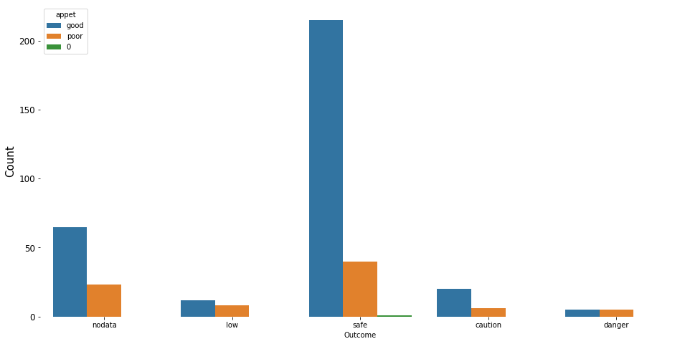

Slide 14
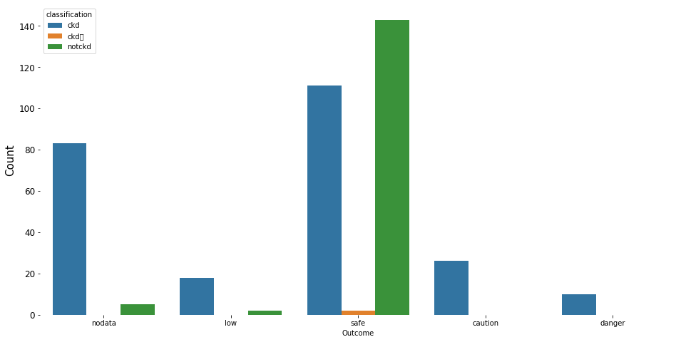

Slide 15
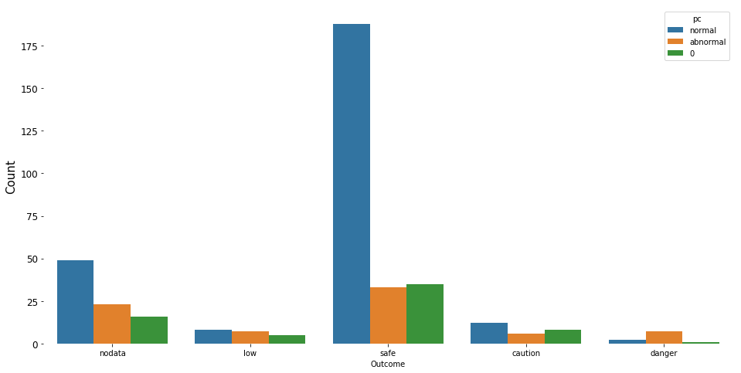

Slide 16
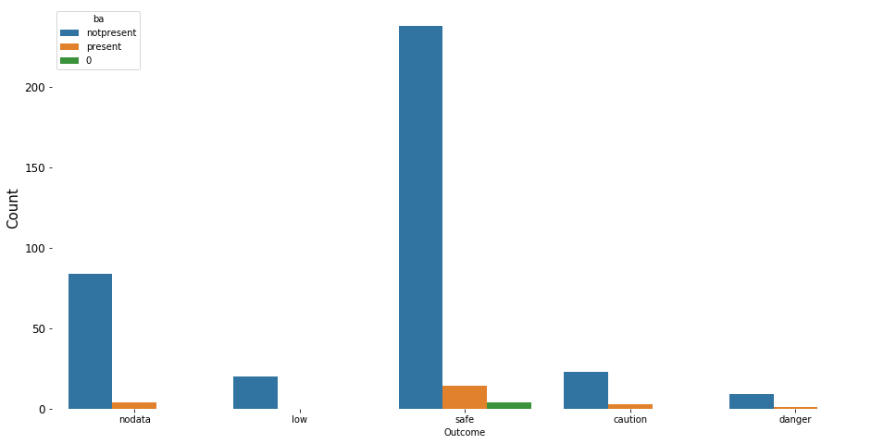

Slide 17
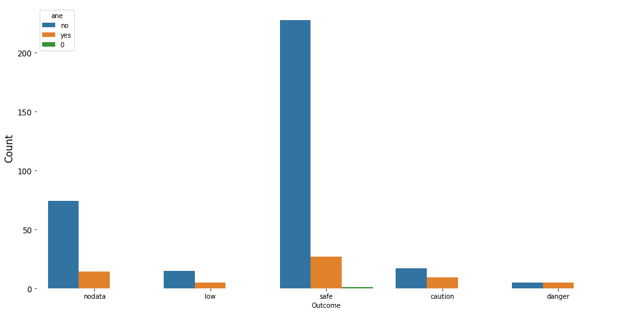

Slide 18
RESULTS

Slide 19
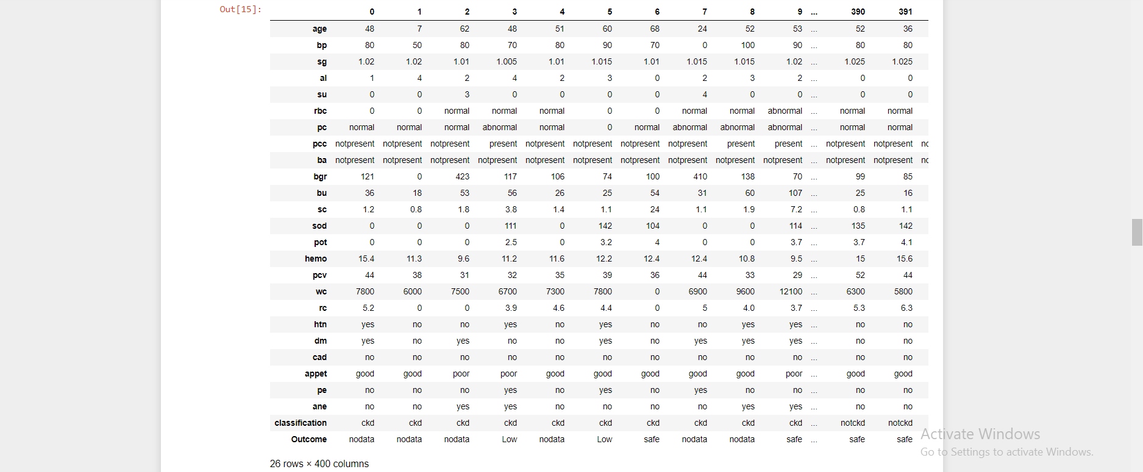

Slide 20
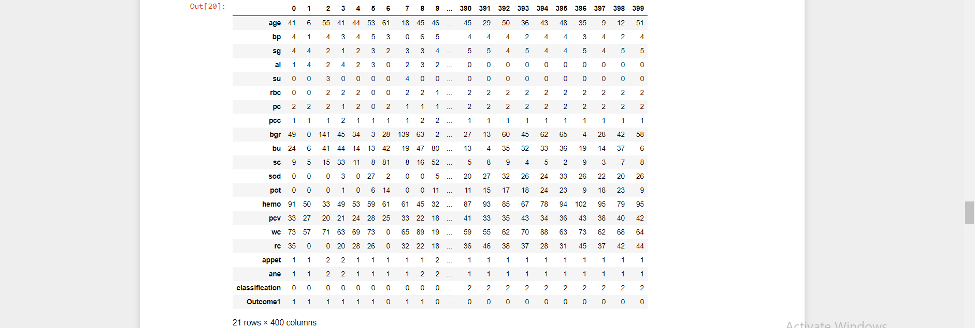

Slide 21
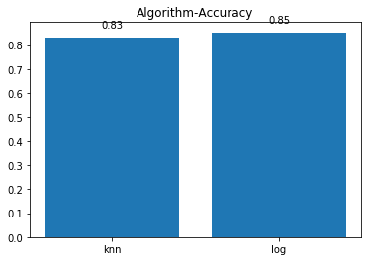

Slide 22


